Slide 1
Enagás, GRTgaz, Reganosa, REN and Teréga
24th SG meeting
21st March 2019

Slide 2
4. VIPs: use of capacity

Slide 3
4.2. VIP Iberico: capacity booking Spanish side

Slide 4
4.1. VIP Ibérico: capacity booking Portuguese side

Slide 5
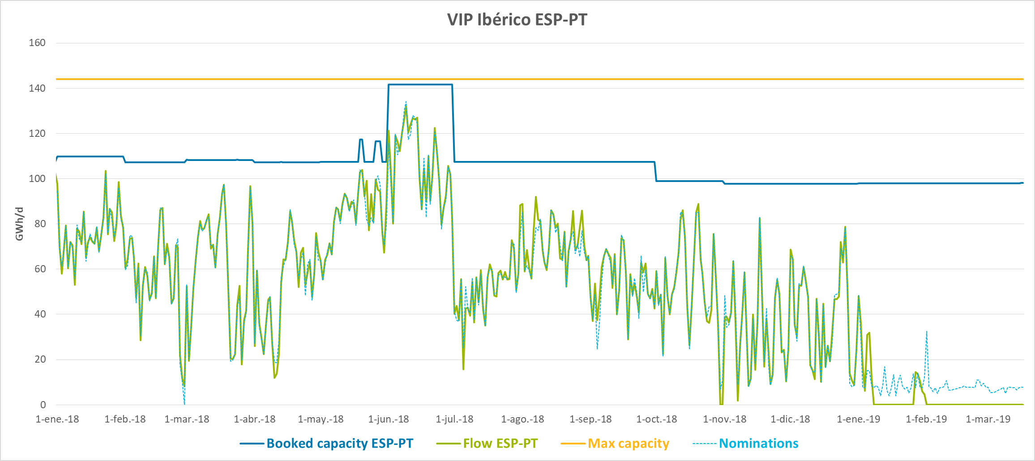
4.1. VIP Ibérico: capacity booking and flows
During the year 2018, main flow direction has been from Spain to Portugal.
Since the beginning of the year 2019 a reversion of flows has been detected.

Slide 6
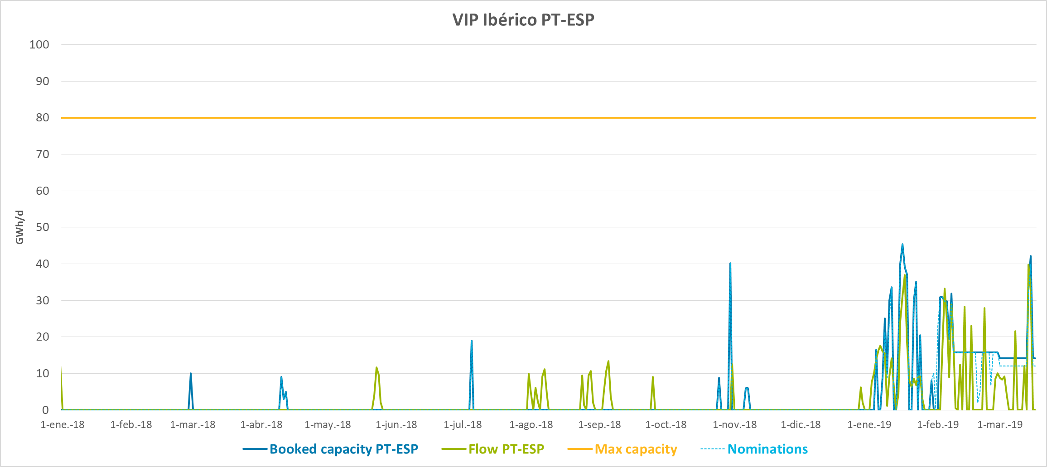
4.1. VIP Ibérico: capacity booking and flows
During the year 2018, punctual activity of the VIP at this flow direction (operational situations)
Since the beginning of the year 2019 an activation of flows, at this direction, has been detected.

Slide 7
4.1. VIP Ibérico: calculation of capacity to be offered in PRISMA for the next 5 gas years
VIP IBERICO
In response to the Iberian NRAs request, TSOs (REN and Enagas) are working on the technical analysis of the capacity to be offered for the next 5 gas year at VIP IBERICO.
This analysis focus on the past behavior of the VIP, flows configurations at both physical points, as well as different tools and mechanisms to maximize capacity.
The foreseeable implementation of a new model of access to the regasification plants in Spain is being considered.
After NRAs approval, technical capacity and capacity to be offered for the next 5 gas year will be published the first Monday of June according to CAM-NC.

Slide 8
4.2. VIP Pirineos: capacity booking Spanish side

Slide 9
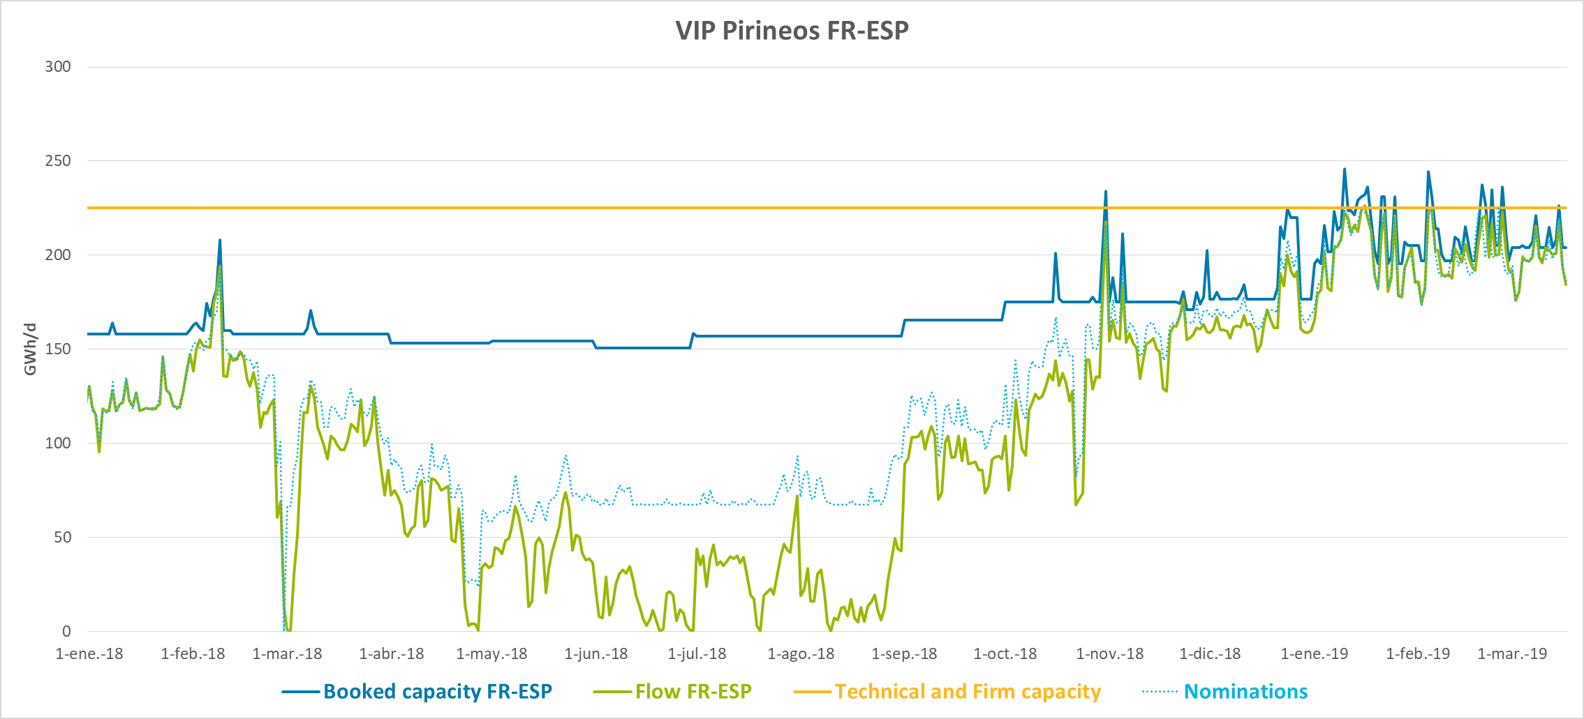
4.2. VIP Pirineos: capacity booking and flows Spanish side
During the year 2018, main flow direction has been from France to Spain.
Since the end year 2018 flows very close to 225 GWh/d ( = Spanish Firm capacity).

Slide 10
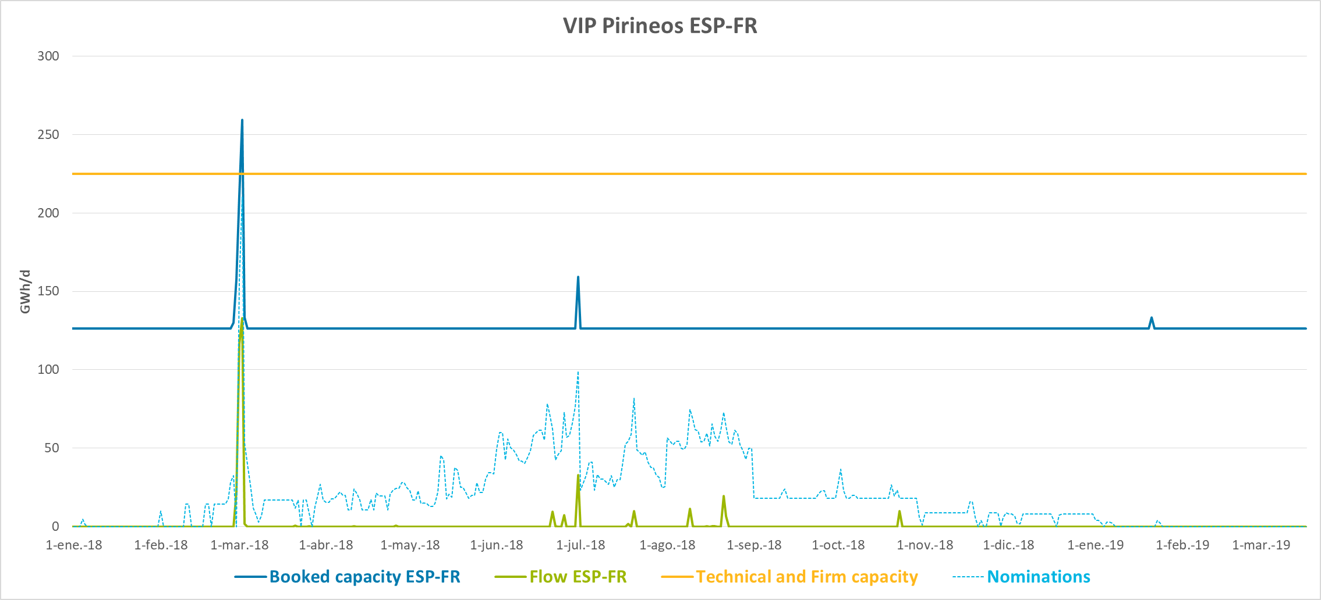
4.2. VIP Pirineos: capacity booking and flows Spanish side
Punctual activity on march´18 owing to ‘Beast of the East’ cold snap

Slide 11
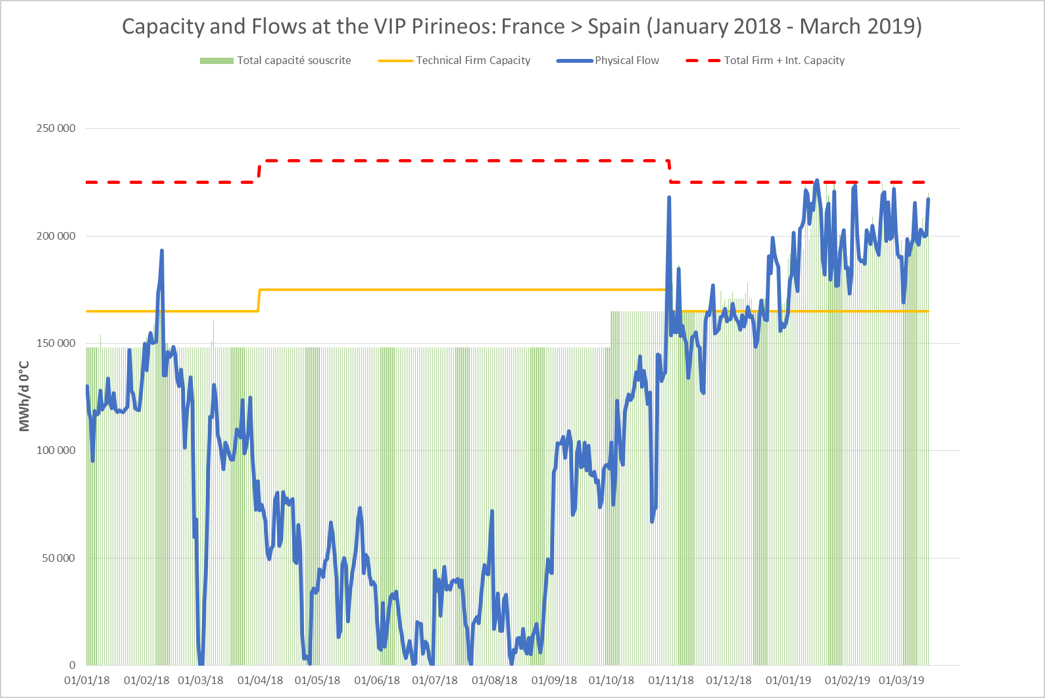
4.2. VIP Pirineos: capacity booking French side

Slide 12
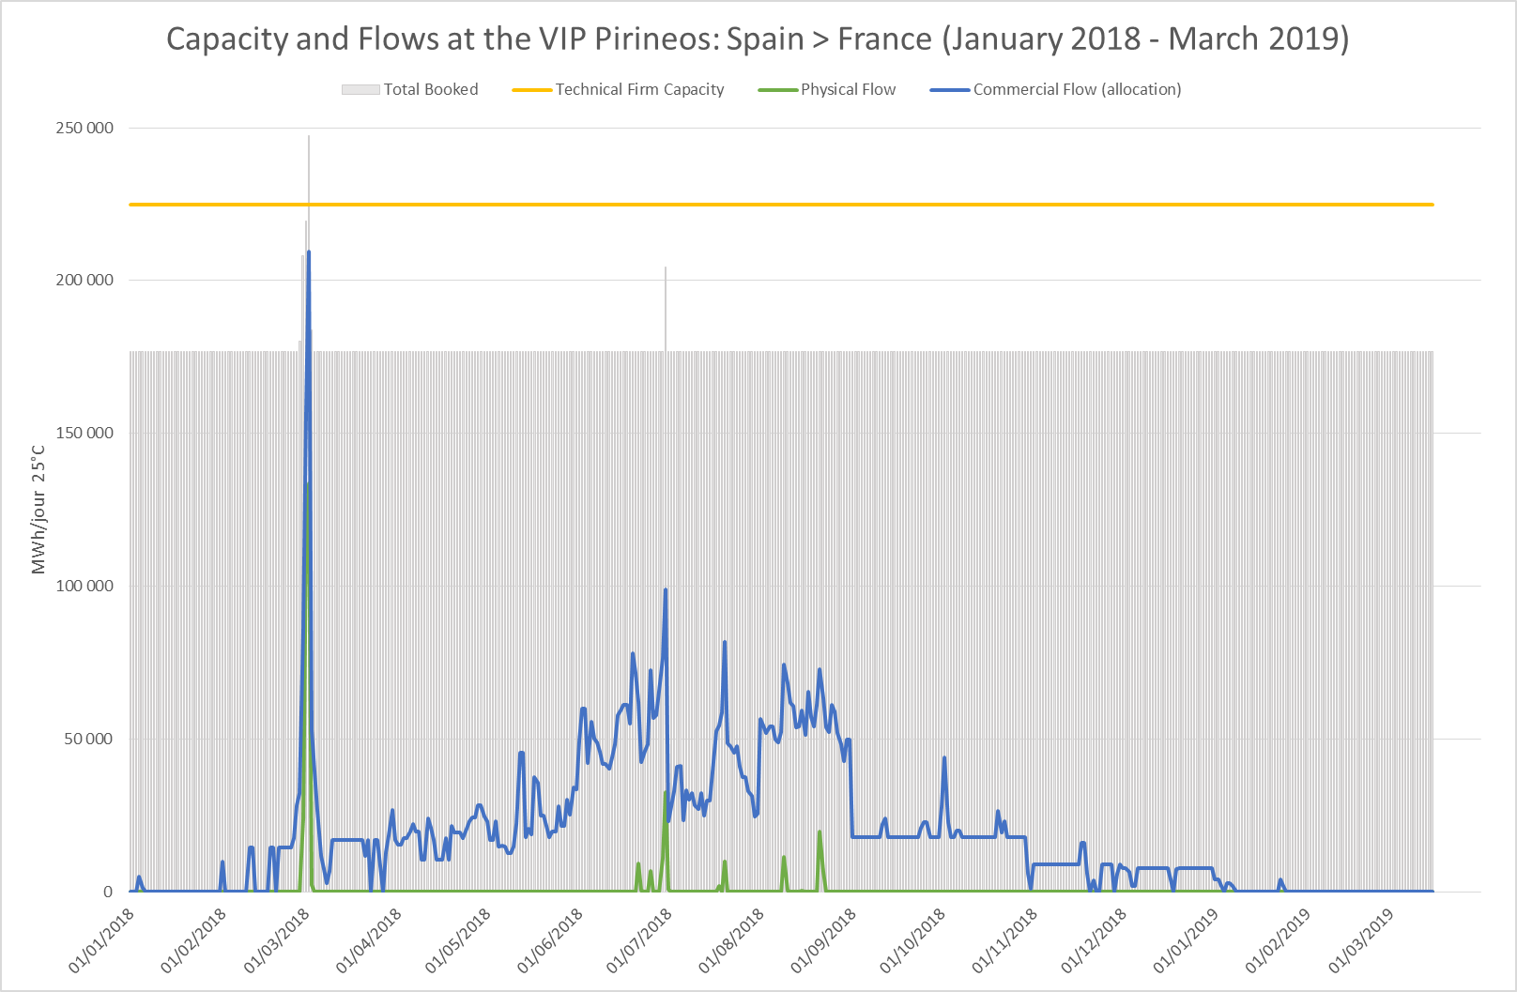
4.2. VIP Pirineos: capacity booking French side

Slide 13
4.2. VIP Pirineos: calculation of capacity to be offered in PRISMA for the next 15 gas years
FR-ES Bundled
ES-FR Bundled

Slide 14
4.2. VIP Pirineos: calculation of capacity to be offered in PRISMA for the next 15 gas years
FR-ES Unbundled
ES-FR Unbundled
 | VIP PIRINEOS ENTRY
Yearly Product | Year 2019
Offer at GWh/d at 0º | 54.250.989
Offer at kWh/h at 25º | 2.254.595
 | VIP PIRINEOS EXIT
Yearly Product | Year 2019
Offer at GWh/d at 0º | 50.370.978
Offer at kWh/h at 25º | 2.093.348
Enagas only offers 1 yearly product of unbundled capacity with the objective of maximizing the bundled capacity offer

Slide 15
4.2. VIP Pirineos: Mechanisms to maximize utilization
There are 2 types of mechanisms to maximize the utilization via offering additional capacity:
CMP Mechanisms
1
Surrender
2
UIOLI LT
3
OS&BB
Interruptible capacity offer*
1
Offer of Day ahead interruptible capacity via auction
Interruptible within day capacity via Overnomination process**
VIP PIRINEOS Entry: 1.148 GWh/d offered in 16 days
VIP PIRINEOS Exit: 200 GWh/d offered in 1 day
2
VIP PIRINEOS Entry: 68 GWh/d booked in 11 days
VIP PIRINEOS Exit: 19,7 GWh/d booked in 2 days
*When 100% of capacity is sold out
**Since 1st January 2018

Slide 16
4.2. VIP Pirineos: Mechanisms to maximize utilization
Priority allocation process
If in an auction there are, additionally to the available capacity, other capacities coming from CMP application, even if the offer is not distinguish, the order of allocation is as follows:
Capacity offered to the market by one or more shippers.
In case more than 1 shipper applies the surrender mechanism, and in case the allocation of capacity in the auction is over the available capacity but does not fulfill the offer of surrender capacity, the shipper which capacity will be allocated will be decided by FCFS, and in case both shippers requested the application of the mechanism the same day, the capacity will be allocated via prorata.
1. Available capacity
Capacity that was underused and that, consequently, it is blocked by the TSO in order to be offered to the market.
In case more than 1 shipper have underused the capacity, and in case the allocation of capacity in the auction is over the available capacity but does not fulfill the offer of UIOLI capacity, prorata will apply over the UIOLI LT contracts.
2. Surrender capacity
The prioritization can only be applied for auctions which products are quarterly or monthly as, the durations applicable for each CMP is:
Surrender: applicable for yearly, quarterly and monthly
UIOLI LT: applicable for quarterly and monthly
OSBB: applicable for day ahead product
3. UIOLI LT capacity

Slide 17
4.2. VIP Pirineos: Mechanisms to maximize utilization
Interruptible capacity offer
COMMISSION REGULATION (EU) 2017/459
Article 32
Allocation of interruptible services
“… 2. Transmission system operators shall offer a daily capacity product for interruptible capacity in both directions at interconnection points where the respective standard capacity product for firm capacity was sold out day-ahead or was not offered.”
Interruptible day ahead capacity offer
Technical capacity
Booked day ahead firm capacity
1. Si TC >= FCB:
ICO= FCB – NCF + NCOF – BDFC
Interruptible capacity Offer
Booked firm capacity
2. Si TC < FCB:
ICO= TC – NCF + NCOF – BDFC
Nominated capacity
TC: Technical capacity (operative)
FCB: Firm capacity booked
ICO: Interruptible capacity offer
NCF: Nominated capacity in the flow
NCOF: Nominated capacity in the opposite flow
BDFC: Booked day ahead firm capacity

Slide 18
4.2. VIP Pirineos: Mechanisms to maximize utilization
Possible situation when day ahead auction closes
As 100% of firm capacity is sold out at both sides of the IP, both TSOs offer interruptible capacity (UBI in the French side and interruptible in the Spanish side)
Interruptible capacity offer in the French side (UBI product): 60/50 GWh/d that the shippers can match with the Spanish unbundled available capacity
There is no offer of interruptible capacity as 100% of firm capacity is not sold out
SP: 225 GWh/d
Booked capacity
FR: 165/175 GWh/d
Booked capacity
Booked capacity
Booked capacity
Booked capacity
Booked capacity

Slide 19
5.2. TYNDP

Slide 20
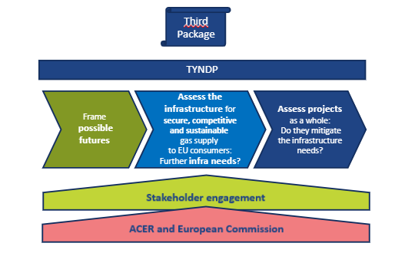
5.2 TYNDP: an ENTSOG regulatory task

Slide 21
5.2 TYNDP Process

Slide 22
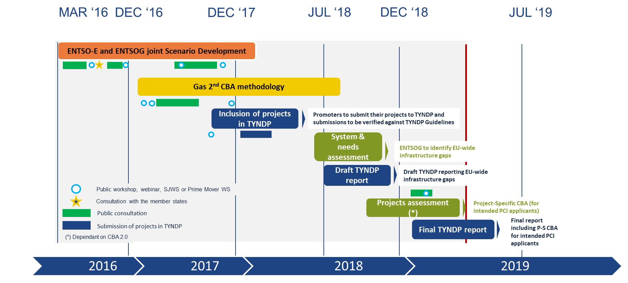
5.2 TYNDP 2018 timeline

Slide 23
5.2 TYNDP 2018 Report Main elements

Slide 24
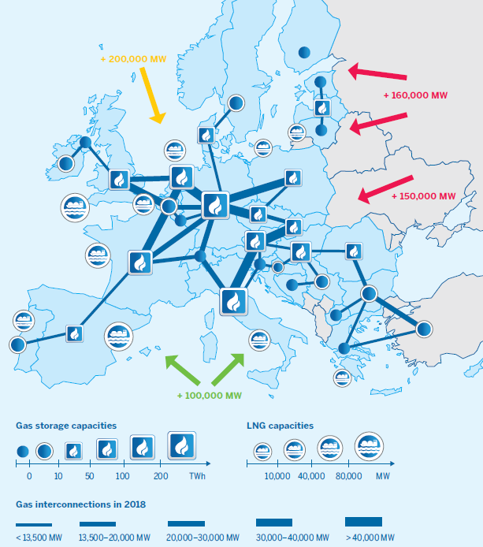
5.2 Existing infrastructure

Slide 25
5.2 Scenarios Characteristics

Slide 26
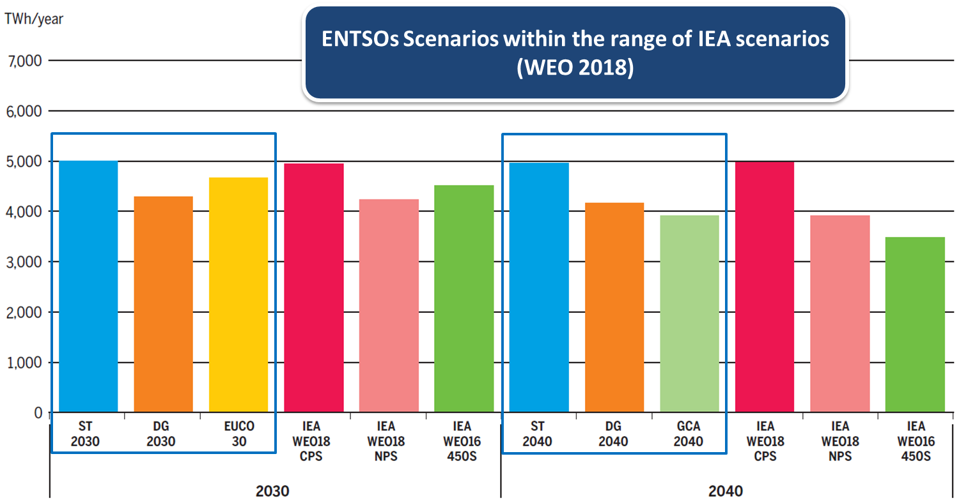
5.2 Gas demand in 2030 & 2040 in line with external scenarios

Slide 27
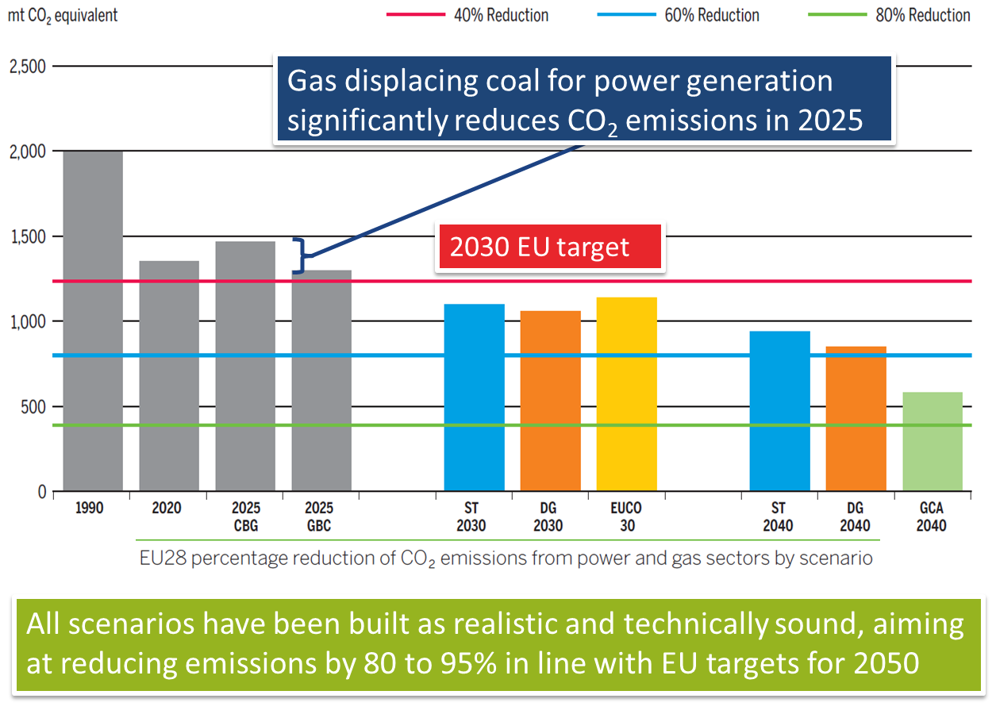
5.2 CO2 reduction: meeting EU targets

Slide 28
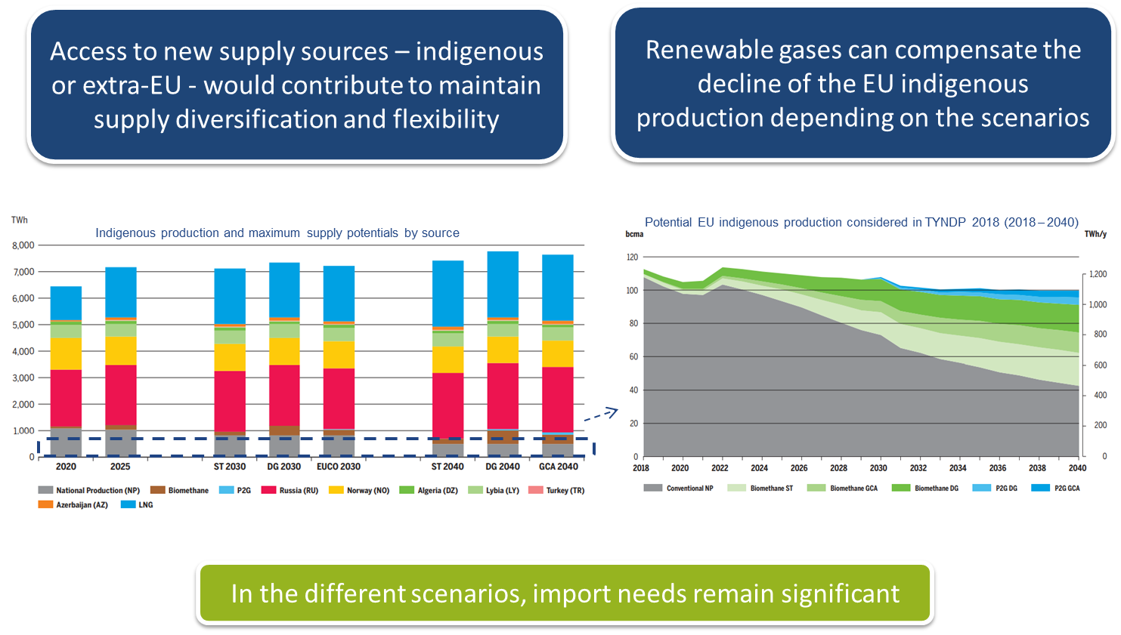
5.2 Supply and demand adequacy

Slide 29
5.2 Main conclusions: security of supply
Already achieved
Resilience to climatic stresses (1-in-20 conditions)
Resilience to a large number of supply & infrastructure disruptions
Further infrastructure needs
Mitigating the impact of Ukraine route disruption in South-Eastern Europe
Mitigating the impact of Belarus route and Russian imports disruption in North-Eastern Europe
To mitigate impact of national largest infrastructures disruptions in specific countries

Slide 30
5.2 Main conclusions: competition & market integration
Already achieved
Most of Europe can access diversified supply sources
The infrastructure allows for efficient cooperation between countries showing low level of dependence on LNG and Russian supply
Infrastructure allows for hub price convergence, especially in Western Europe
Most countries have balanced entry capacities in comparison to their geographical location
Further infrastructure needs
To ensure more diversified access to supply sources – in the Baltics, South-East Europe and Iberian Peninsula
To lift high dependence to a specific supply source

Slide 31
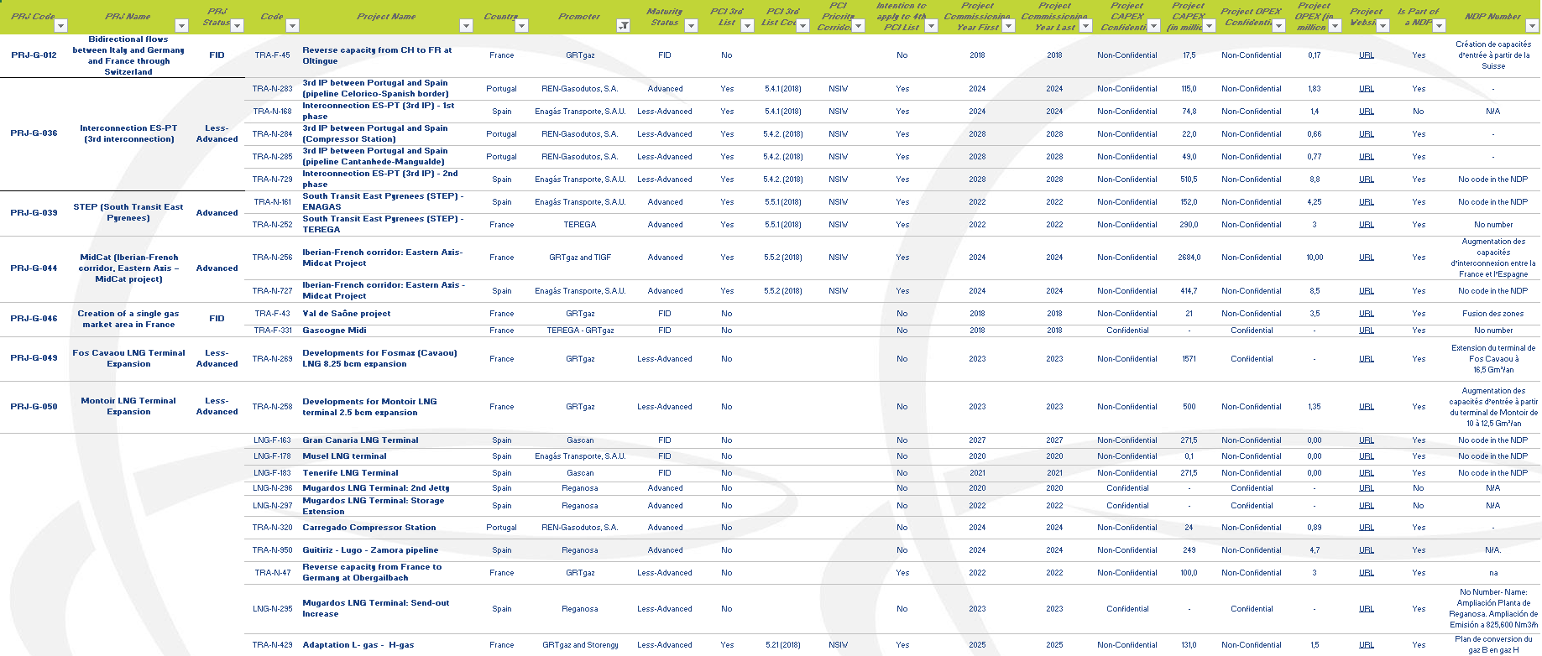
5.2 Projects submitted by the Region

Slide 32
5.2 Conclusions
Stakeholder are welcome to take part to the TYNDP public consultation (until 29 March)
https://entsog.eu/entsogs-tyndp-presentation-day-draft-ten-year-network-development-plan-tyndp-2018#
More on TYNDP 2018:
https://www.entsog.eu/tyndp#entsog-ten-year-network-development-plan-2018

Slide 33
6.1. 2019 list: project candidates of PCIs in the Region

Slide 34
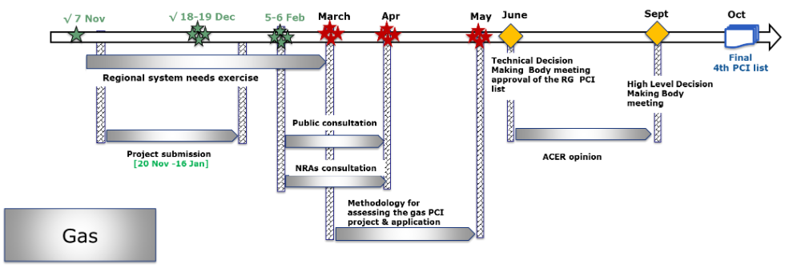
6.1. PCI process gas

Slide 35
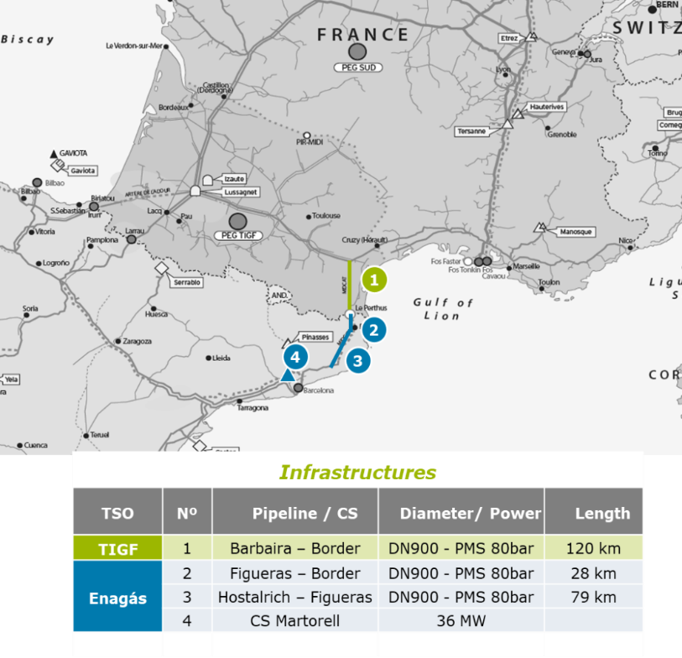
6.1. STEP
STEP project:
Key interconnection for creating energy solidarity among the countries of the EU.
Given its technical characteristics, STEP will be able to transport gas from North to South (from France to Spain) or from South to North (from Spain to France).
Bidirectional pipeline: will make EU energy prices more competitive, driving energy supply diversification. Studies have predicted mostly North to South flows.
However, this will depend on:
Gas supplies from various worldwide gas fields, especially from Russia and the North Sea.
Evolution of gas consumption patterns in France and the Iberian Peninsula.
Increased use of LNG in Europe (as highlighted in July 2018 Lisbon Declaration: the strategic importance of LNG in diversifying EU energy sources and supplies).
TSO | No. | Pipeline / compressor station | Length / Power | CAPEX (M€) | Total (M€)
Teréga | 1 | Barbaira – Border | 120 km | 290 | 290
Enagás | 2 | Figueras – Border | 28 km | 27 | 152
 | 3 | Hostalrich – Figueras | 79 km | 72
 | 4 | Martorell CS | 36 MW | 53

Slide 36
6.1. 3rd IP between ES-PT (1st phase)
3rd IP between ES-PT project (1st phase):
Key interconnection for creating energy solidarity among the countries of the EU.
From a European perspective, the project aims to integrate the European systems and, therefore, an internal gas market development;
Supplemented with the development of STEP project, it also aims at ensuring that no Member State is isolated from the European network, as well as, reinforce the security of supply in any system, increasing the solidarity between countries in all of Europe, more specifically:
The project slightly improves diversification of entry points (LICD) in Portugal and Spain, by increasing the capacity between the two countries;
In case of disruption of the single largest infrastructure (SLID) in Portugal, the potential demand curtailment is halved;
In case of disruption of Algerian supply, the project slightly mitigates the risk of demand curtailment in Spain, because, with Carregado CS, Portugal is able to send gas to Spain, allowing further cooperation among the two countries;
The bi-directionality is improved by 49% (from 43% to 92%). The project creates more capacity from Portugal to Spain balancing both sides of the interconnection;
The capacity provided by the Project, will be fundamental for the market integration of the Portuguese and Spanish markets, playing an enabling role, in case of an eventual market merger between the two countries.
Note: Information extracted from TYNDP 2018 Project fiche West 04
1
1
2

Slide 37
7.1. Market-based instruments in the TRF

Slide 38
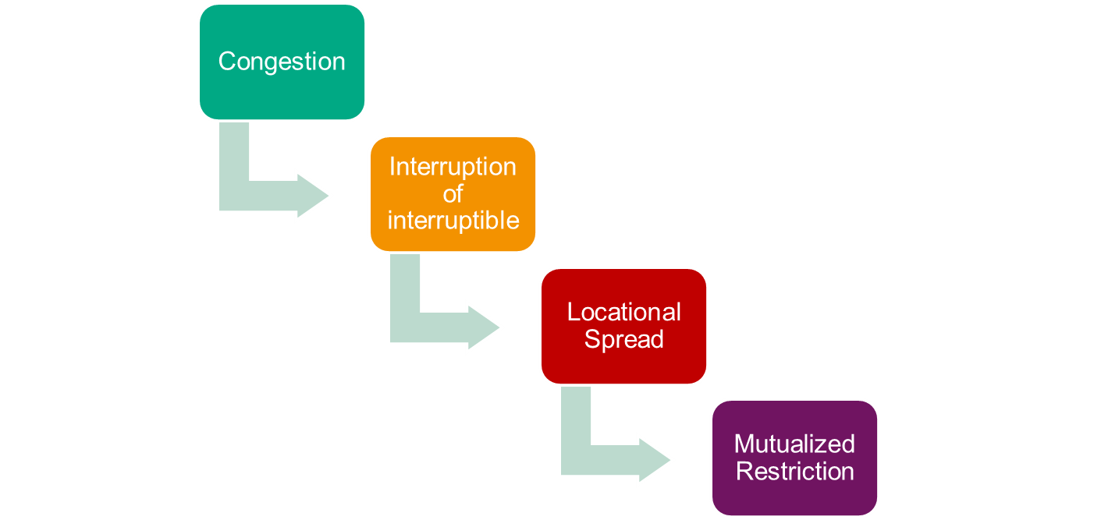
7.1. Market-based instruments in the TRF
Hierarchy of measures
The decisions of the CRE of 26 October 2017 and 24 July 2018 specify the modalities of use of the mechanisms for management of congestions.
In particular, the mechanisms are hierarchized in this way:
*
*
Ensured usability, if needed, by means of a Flow Commitment beforehand

Slide 39
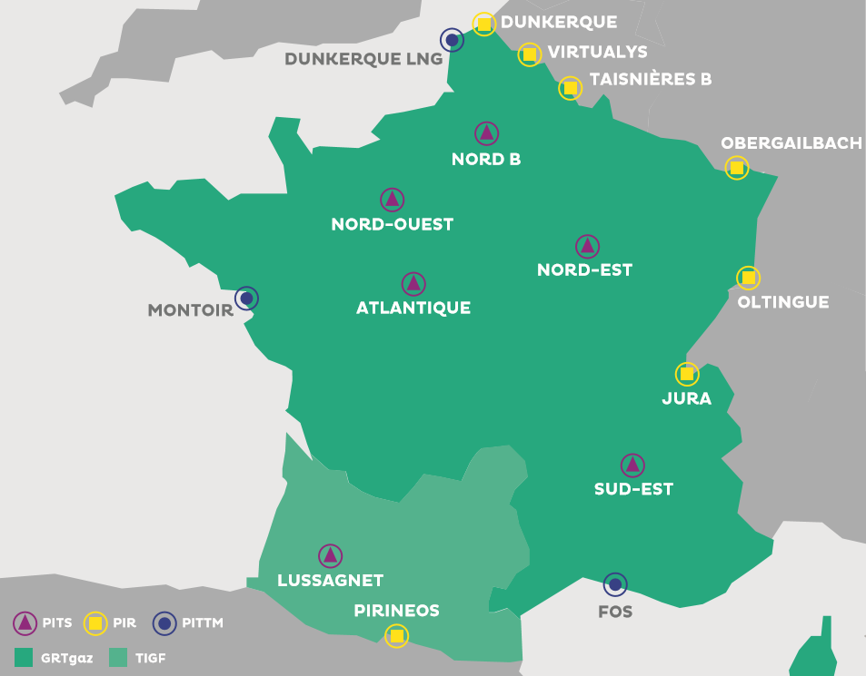
7.1. Market-based instruments in the TRF
LOCATIONAL SPREAD
Main mechanism for management of the residual limits
Optimised cost : activated within-day only when a proven limit is reached and only for the quantity necessary to resolve the limit
Market product, relying on the gas stock exchange with a within-day locational product:
Purchase by TSOs downstream of the limit
And simultaneous sale of the same quantity by the TSOs upstream of the limit
TSOs buy a “spread” through this simultaneous buy&sell

Slide 40
7.1. Market-based instruments in the TRF
A flexible mechanism : via a call for tenders for voluntary shippers, for the purchase, sale, or both, for the quantities that they choose
Neutral impact of the locational spread on the balancing of the selected shipper (the PEG nomination balances the physical nomination)
Prerequisite at least : accreditation with Powernext to access on CMP platform

Slide 41
7.1. Market-based instruments in the TRF
FLOW COMMITMENT
Concertation Gaz, Public Consultation, Deliberation of 24/07/2018
The Flow Commitment is a market mechanism enabling contractualisation by the TSOs of a gas flow downstream of the limits, at points other than storage facilities
Mid-term reserve mechanism, complementary of other TRF mechanisms
The short-term mechanism, Locational Spread, relies on storage flexibility
Storage levels are monitored to anticipate the risk of lack of flexibility
Monitoring uses the known consumption and supply information for the next 15 days
After these 15 days the "extreme" scenarios are applied
If critical situation anticipated → TSOs may trigger the Flow Commitment

Slide 42
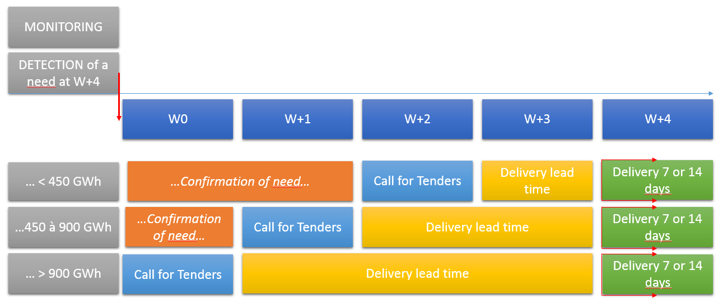
7.1. Market-based instruments in the TRF
Call for Tenders: Timeframe and Volume

Slide 43
7.1. Market-based instruments in the TRF
Call for Tenders – Consultation
Deadline for offer submission;
Eligible points;
Delivery start date;
A total volume to be delivered through a specified period;
Lot size = 50 GWh
A maximal daily flow rate due on each delivery day specified on Day-1;
A ratio volume/flow rate
Call for Tenders – Selection process
Offers submission:
Each offer must specify a volume less or equal to the need
Offers selection:
TSOs select offers under the rule of covering the need at least cost

Slide 44
Thank you for your attention!

