Slide 1
Enagás, GRTgaz, REN and TIGF
31st IG meeting
26th February 2015

Slide 2
II.2 TSOs proposal of common methodology to maximize technical capacity

Slide 3
II.2 TSOs proposal of common methodology to maximize technical capacity
  With the scope of maximizing the offer of bundled capacity, a joint method for optimization of technical capacity has been established and applied for several years for all the interconnections between TIGF and Enagás, as well as between REN and ENAGAS, despite no related documentation has been published.
  This joint method:
    Includes an in-depth analysis of the technical capacities
    Solves discrepancies therein on both sides of an interconnection point
    Establishes a detailed timetable in line with possible regulatory requirements and commercial needs.
    Is consistent with National Investment Plans and Union-wide TYNDP assumptions.
    Takes into consideration the best information provided by the market regarding future flows
    Is regularly updated, especially when critical changes in demand or infrastructures are identified

Slide 4
II.2 TSOs proposal of common methodology to maximize technical capacity
    Agreement in DEMAND criteria's regarding design scenarios for calculations: Worst case scenario is selected for each direction:
        Import point of view → summer average demand
        Export point of view → peak demand.
      Agreement in terms of INFRASTRUCTURES and OPERATIONAL SETTINGS:
      Infrastructure scenarios
      Commission of new investments
      Operational settings for compressor stations or other relevant points in the network
TSO 1 simulation
TSO 2 simulation
    Agreement in SIMULATIONS:
      Saturation of the infrastructures linking the core network with the interconnection
Saturation of the infrastructures linking the core network with the interconnection
VIP Pirineos: agreed conditions between 2 Compressor Stations → Equivalent to 1 single simulation
VIP Iberico: agreed condition is the Border pressure → lesser rule should be applied to the capacity calculated by each TSO.

Slide 5


II.2 TSOs proposal of common methodology to maximize technical capacity
    Results calculated on each side are contrasted during several meetings and discussions until reaching a decision of the maximum technical capacity.
    Calculation Updates
      Once a year
      Nevertheless, each TSO reserves the right to review the capacity value in case of critical changes such as unpredictable demand variations at wide or local level, in case of commissioning of new infrastructures that may have an impact in cross-border capacities, or changes in the operative conditions of any facility working in the network.
      Two year period → If no changes in the main assumptions

Slide 6
II.2 TSOs proposal of common methodology to maximize technical capacity
  ALREADY DONE:
    Questionnaire submitted to ENTSOG
    Technical note regarding VIP Pirineos calculation submitted to NRA’s
  FOLLOWING STEPS:
    Feedback and expectations from Regulators
    Methodology should be published? If so, regulatory treatment
Further details of the technical capacity calculation and optimisation can be found on TIGF, REN and Enagás websites:
http://www.tigf.fr/en/what-we-can-offer/transport/capacity-trading/capacity-calculation.html
https://www.ign.ren.pt/web/guest/sub-regulamentacao (Procedure n.º 1)
http://www.enagas.es/stfls/EnagasImport/Ficheros/667/432/NGTS%20-actualizaci%C3%B3n%20dic-13,0.pdf (NGTS-02)
http://www.enagas.es/stfls/EnagasImport/Ficheros/912/744/PD%20-actualizaci%C3%B3n%20may-13.pdf (PD-10)

Slide 7
II.3 Status of TSO’s IT systems for adaptation to daily auctions by 1st November 2015.

Slide 8
II.3 Status of TSO’s IT systems for adaptation to daily auctions by 1st November 2015
Implementation of the nomination and re nomination scheme
“Common Business Requirements Specification for Nomination and Matching” Document
  Pending issues
    Minor wording refinements
    Expected date of the agreement: 1st April 2015

Slide 9
II.3 Status of TSO’s IT systems for adaptation to daily auctions by 1st November 2015
Implementation of the nomination and re nomination scheme
“Technical Requirements Specification for IT Systems Connection“ Document
  Pending issues
    Updating of ““Technical Requirements Specification for IT Systems Connection“ Document
    Expected date of the agreement: 1st April 2015

Slide 10
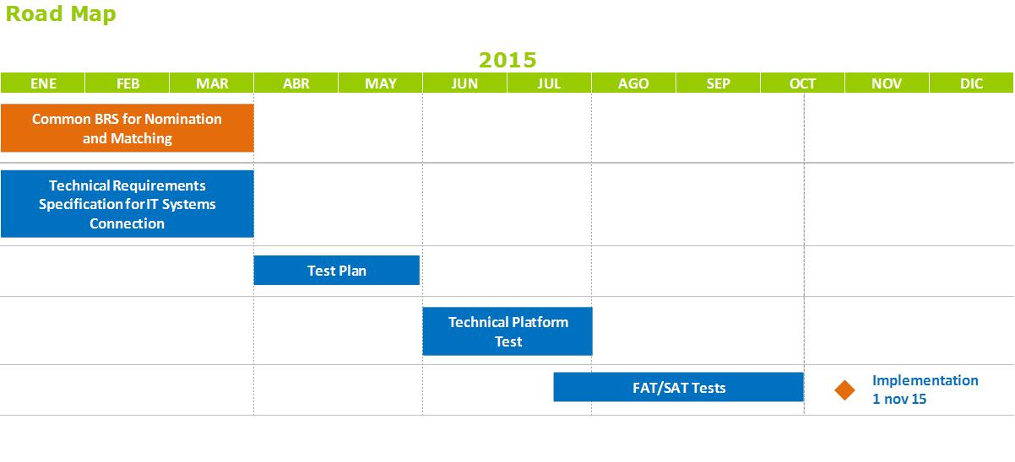
II.3 Status of TSO’s IT systems for adaptation to daily auctions by 1st November 2015
Implementation of the nomination and re nomination scheme
  Road Map

Slide 11

II.3 Status of TSO’s IT systems for adaptation to daily auctions by 1st November 2015
  Enagás Project Planning 2015
2014
2015
2016
Projects
Jan
Feb
Mar
Apr
May
Jun
Jul
Aug
Sep
Oct
Nov
Dec
Q1
Q2
Q3
Q4
Daily & whithin-day auctions
2014 Closure of Requirements
Start of the tests
Implementation
Gas Day, PCS/Wobbe & C. Ref.
Closure of Requirements
Start of the tests
Gas Day
PCS/Wobbe & C. Ref.
Secondary Market (re-sell & sublet)
Closure of Requirements of Resell
Implementation of Resell
Implementation of Sublet (best forecast )

Slide 12
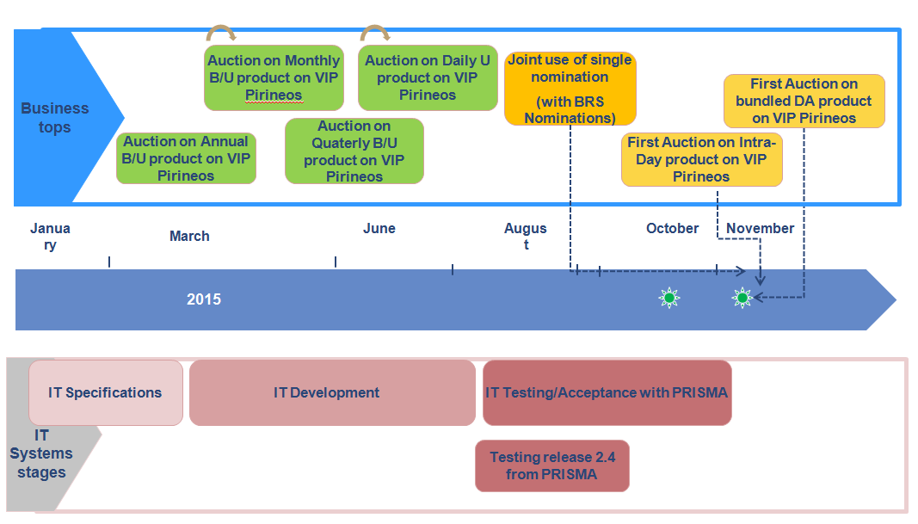
II.3 Status of TSO’s IT systems for adaptation to daily auctions by 1st November 2015
TIGF road map

Slide 13
III. CMP: common methodology of OSBB for the Region

Slide 14
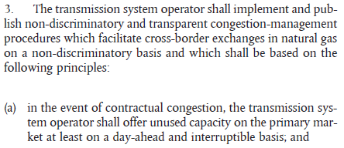
III. OS methodology - Premises
The obligation for CMPs:
Regulation (EC) 715/2009 “Gas regulation” Art. 16 (3):
(…)
  Taking into account the joint Enagás/TIGF methodology proposal for VIP Pirineos
And considering:
  CMPs implementation, in particular the OSBB, should be in line with the evolution of system variables such as booking levels and network complexity through risk assessment, allowing adaptation of calculation frequency
  Thereafter, the development efforts and related costs of this implementation shall be adapted to its effective need over time
  There is a potential high risk when offering additional capacity, therefore, when the capacity booked at VIP Ibérico rises up to 90% consistently, NO simplifications should be applied to the methodology implementation in order to harmonize the methodology in the three countries

Slide 15
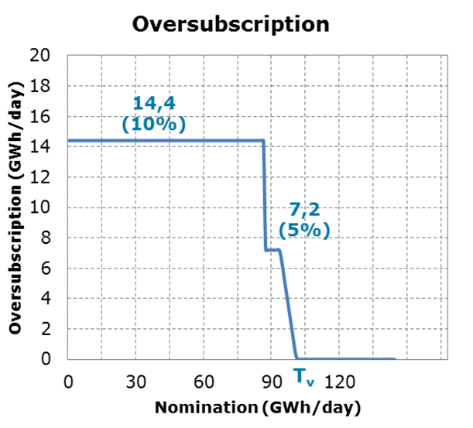
III. Methodology Enagás/TIGF applied to VIP Ibérico
The methodology is based on the difference between nomination and last renomination
The additional capacity is offered on daily basis

Slide 16
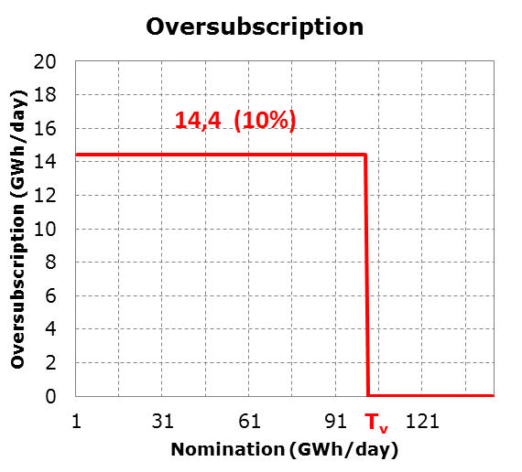
III. Proposal to simplify the VIP Ibérico OS Methodology
The methodology is based on the difference between nomination and last renomination
The additional capacity is offered on daily basis
One single step in order to simplify the methodology

Slide 17
III. Current status of the OS Methodology for VIP Ibérico
Agreed Points of the METHODOLOGY
  The aim of the methodology is based on the difference between the nomination and the last renomination
  The additional capacity is offered on daily basis
  There is a nomination value (Trigger Value) from which offered additional capacity is 0 GWh / day
Agreed points in the application of the methodology on the VIP Ibérico
  Simplification of the function in a single step
  Frequency of calculation:
    Annually:
      A: % additional capacity to bid on Nominal capacity (+ 10%)
      f: Safety factor (10%)
      MO: Operational margin (25% of OBA)
    Monthly (or shorter, depending on continuous monitoring):
      Trigger value Tv = Cn - IR - MO
    Daily:
      Nomination assessment against the Trigger Value

Slide 18
III. How to offer OS capacity
  OS capacity will be sold in the daily auction together with the available capacity.
    If not sold, the OS capacity will not be reoffered again in the within-day auctions.
    Otherwise, complexity will be increased, because OS capacity should be recalculated before each auction (time constrains).
  OS capacity will be sold as bundled.
    The methodology proposed for calculating the OS capacity ensures that the OS capacity will be always the same at both sides of the VIP
    Each TSO will upload at PRISMA its daily available capacity (technical + OS capacity)
    PRISMA will apply the lesser value to determine bundled capacities. The remaining capacity, if any, will be sold as unbundled

Slide 19
III. OS bundled capacity
  Taking into account that the OS capacity is calculated based on nominations, the OS capacity will also be the same value
OS capacity will be offered as bundled capacity
OS capacity
OS capacity
Bundled capacity
Technical capacity
Technical capacity
Booked capacity
Booked capacity
Unbundled capacity

Slide 20

III. When will the buy-back process be triggered?
If: Σ Net nominations > technical capacity → technical and commercial measures and, if necessary, buy-back
Merit order of technical and commercial measures before buying back the capacity:
Management of the OBA
Interruption of the interruptible capacities under the following order:
  Within day interruptible capacity (overnomination)
  Daily interruptible capacity
  Monthly interruptible capacity
  Quarterly interruptible capacity
  Yearly interruptible capacity
Buy-back of oversubscribed capacity
Pro-rata between all firm capacities
Nominations
Technical Capacity

Slide 21
III. When will the buy-back process be triggered?
Situations where the operational capacity is below the technical capacity
In this case it is clear that BB should not be triggered, TSOs should apply the same procedure as currently in place
In this case BB should not be triggered, TSOs should apply the same procedure as currently in place
OS capacity
Nominations
OS capacity
Technical capacity
Technical capacity
Need for capacity reduction
Nominations
Operational capacity
Operational capacity

Slide 22

III. How much will be needed to buy-back?
If: Σ Net nominations – OBA – Interruptible capacity > Technical capacity → Buy-back process
The capacity subject to buy-back will be calculated as follows:
Buy-back capacity = Net nominations – OBA – Interruptible capacity – Technical capacity

Slide 23
III. Communication to the adjacent TSO & shippers
The TSO will inform the adjacent TSO about the need to buy-back capacity
Shippers will be informed about the restriction of their re-nomination rights upwards.
The TSO will inform shippers about:
  The amount of capacity to be bought-back
  The maximum price the TSO is willing to pay
  Which shippers are allowed to sell capacity
  The maximum amount of capacity each shipper can sell.

Slide 24


III. Timeline for the BB process
BB information to be sent to platform
Start of the BB process on PRISMA platform
Communication of the results
hh:mm
06:00 D
17:00 D-1
06:00
End of DA auction with OS capacity
BB process to be finished before the start of the gas day
Nominations
Information of the relevant data necessary to carry out the BB

Slide 25
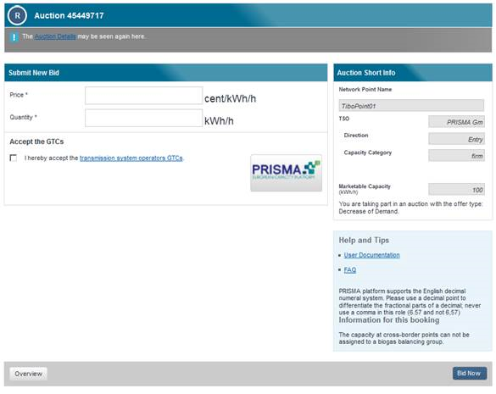
III. Buy-back procedure (I)
The capacity will be bought back using PRISMA Platform as bundled capacity or as unbundled capacity by the same legal entity on each side of the IP
PRISMA offers several options to TSO to buy back capacity:
  Primary reverse auction
  (used by GTS and also German TSOs;
  no price indication; 30 min time window;
  maximum product runtime is 24 hours)
  Secondary platform
  (more familiar to shippers)
  FCFS
  OTC
  CFO - requires setting specific rules for bidding and determining winning bids

Slide 26
III. Buy-back procedure (II)
If users do not offer enough capacity in the buy-back procedure, TSOs will reduce firm capacities according to pro-rata rule. The payable price will be set for each system according to national rules:
  On the French side, TIGF will pay 100% of the weighted average of the previous quarterly, monthly and daily auction settlement prices
  On the Spanish side, Enagás will pay the regulated tariff
  On the Portuguese side, REN will pay 110% of the payable price of the corresponding reduced capacity product

Slide 27
III. Buy-back procedure (III)
  Based on the requirements of the European Commission, an incentive-based scheme should be put in place:
  In France:
    CRE’s deliberation (27/06/2013): the revenues generated by the OS and of the costs generated by the BB are covered at 50% by the CRCP (tariffs).
    Buy-back price: the CRE deliberated that it should reflect a market price while covering risks for the TSO.
      Therefore the maximum BB price should be equal to 125% of the weighted average of the previous quarterly, monthly and daily auction settlement prices.
  In Spain:
    CNMC decision: same principle with a ratio of 10% for the TSO and 90% for the network users (tariffs).
    In the Spanish system, network users can offer their capacity to be bought back at a maximum price equal to 25% the reference price, which should be defined in coordination with the adjacent TSOs
1
2

Slide 28
III. Buy-back procedure (IV)
3
  In Portugal:
    ERSE’s Directive 14/2014, of 4 August, determines that the revenues generated by the OS and the costs generated by the BB are split between TSO and network users in a proportion of 10/90
    The price of the capacity that network users may offer at the BB auction shall not exceed the reserve price for firm day-ahead capacity multiplied by a factor of 1,20
The cost of the capacity bought back will be split among the TSOs
Issues to be agreed
How to fix the maximum buy-back price to be paid by both TSOs?
How to split the costs of the buy-back between the TSOs?

Slide 29
III. Buy-back price (I)
Indicative Options:
If the maximum price is the sum of the maximum prices of both TSOs, the split can be done by:
OPTION A: Each TSO will pay the user up to the corresponding regulated tariff considered for his side and the remaining cost could be split:
50/50 between each TSO
Pro-rata regulated price
Pro-rata the maximum price
Neither of the options is possible, TSOs could not pay more than max. price

Slide 30
III. Buy-back price (II)
Indicative Options:
If the maximum price is the sum of the maximum prices of both TSOs, the split can be done by:
OPTION B: Split the final price to be paid to the shipper:
50/50 between each TSO
Pro-rata regulated price
Pro-rata the maximum price
Only option 2: pro-rata maximum price is feasible

Slide 31
III. Buy-back price (III)
Indicative Options:
If TSOs and NRAs consider that the most suitable way to split the cost is 50/50, then the maximum price to be paid by both TSOs should not be built as the sum of each maximum price
50/50 split

Slide 32
III. Buy-back price (IV)
There are many possibilities on how to split the cost of the buy-back.
Each NRA have published a maximum price to be paid by each individual TSO
Thus, in previous slides it is only shown how to split the cost sticking in each system taking into national regulation already published in each system
Percentages can also be adapted and further agreed, if this is the case, more options about the split of costs could be envisaged.
NRAs and TSOs coordination and agreement is needed

Slide 33
V.2 Candidate projects of common interests in the Region

Slide 34
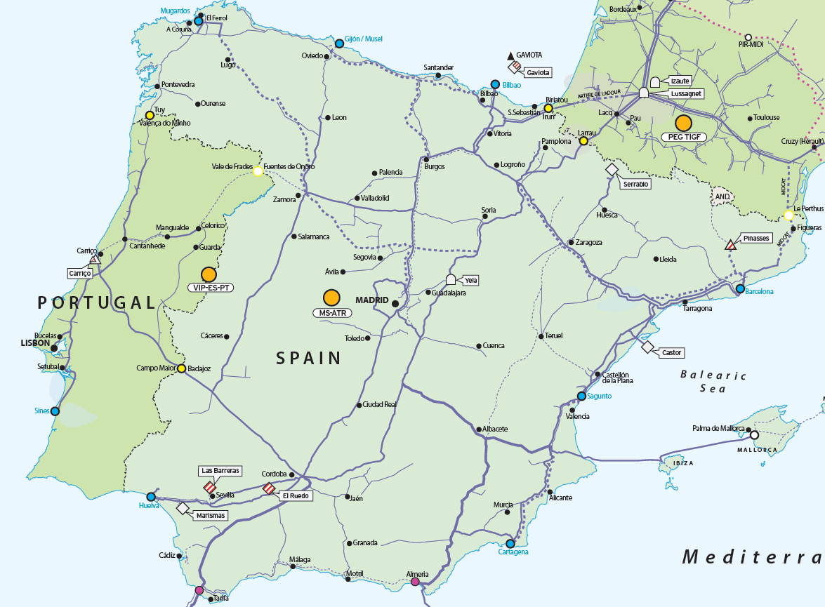
PCI 5.4. - 3rd Interconnection point between Portugal and Spain
Portugal
1
2
3
Phase | ENTSOG Code | Infrastructures | Capacity GWh/d | Lenght km | Diameter ‘’ | Power MW
 | TRA-N-283 | Pipeline Celorico -Spanish Border | Entry: 75 Exit: 50 | 162 | 28 | -
 | TRA-N-284 | Cantanhede Compressor Station | Entry: 107 Exit: 97 | - | - | 12
 | TRA-N-285 | Pipeline Cantanhede -Mangualde | Entry:141.4 Exit: 141.4 | 67 | 28 | -
1
2
3

Slide 35
PCI 5.4. - 3rd Interconnection point between Portugal and Spain
Spain
3
1
2
ENTSOG Code | Infrastructures | Capacity GWh/d | Length km | Diameter ‘’ | Power MW
TRA-N-168 | Pipeline Zamora-Portuguese Border | Entry: 100 Exit: 100 | 85 | 28
 | Zamora CS |  |  |  | 23
 | Core network reinforcements in Spain |  | Core network reinforcements in Spain under study*
1
2
(*) After the submission of the info to DG ENER, Enagás has identified the following core network reinforcements | Guitiriz-Yela Pipeline (G6) | Entry: 142 Exit: 142 | 625 | 26/30/32
3

Slide 36
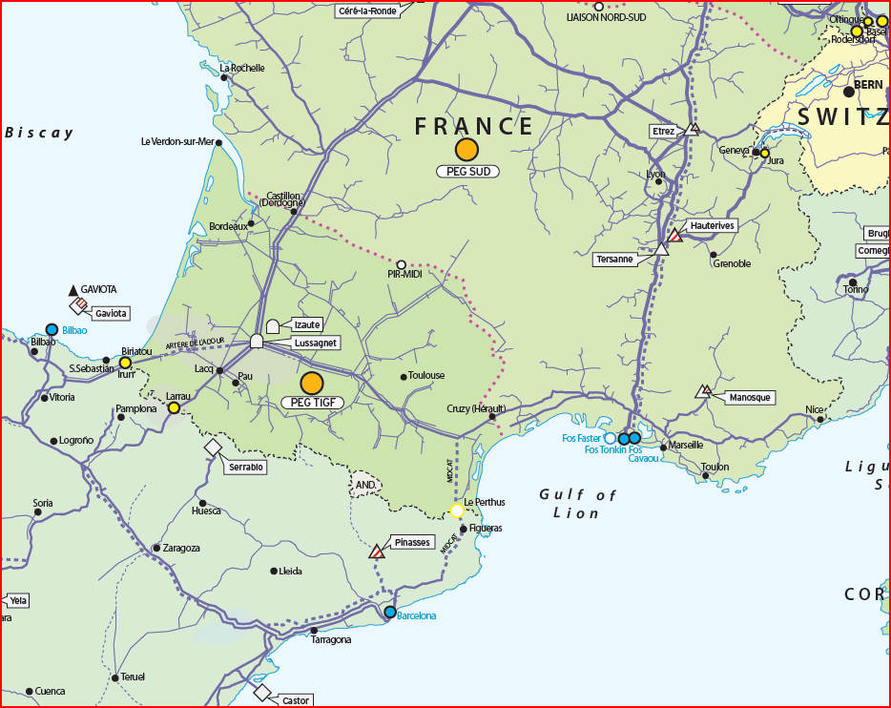


MIDCAT
  Pipeline between French border and Figueras (25km)
  Pipeline between Figueras and Hostalrich (79km)
  Compression at Martorell (36MW)
  Loop between Tivisa and Arbós (114 km)
  Loop between Villar de Arnedo and Castelnou (214 km)
New compression in Montpellier
Reinforcement of compression in Saint-Martin-de-Crau
CS Montpellier
CS Barbaira
CS Saint-Martin-de-Crau
  Pipeline between Spanish border and compression station of Barbaira (120km)
  Reinforcement of compression station at Barbaira (10MW)
  Pipeline between Lupiac and Barran (28km)
CS Martorell

Slide 37
PCI candidates reported by GRTgaz as MidCat enablers
Arc Lyonnais
Pipeline between St Avit and Etrez (Arc Lyonnais, 150km in DN1200)
Pipeline between St Avit and St Martin (Eridan, 220km in DN1200 )
Eridan
GRTgaz proposes Arc Lyonnais and Eridan, PCI candidates for the 2015 list, as enablers for MidCat.
It is still under discussion in the Regional Gas Group, regarding the grouping for the Project-Specific CBA simulations (PS-CBA), whether MidCat should be simulated alone, or if these two projects should be grouped with MidCat.
An agreement at the Regional Gas Group is pending.

Slide 38
MIDCAT + enablers
  Pipeline between French border and Figueras (25km)
  Pipeline between Figueras and Hostalrich (79km)
  Compression at Martorell (36MW)
  Loop between Tivissa and Arbos (114 km)
  Loop between Villar Armedo and Casternou (214 km)
Arc Lyonnais*
Pipeline between St Avit and Etrez (Arc Lyonnais, 150km in DN1200) as partial enabler
Pipeline between St Avit and St Martin (Eridan, 220km in DN1200 ) as enabler
New compression in Montpellier – reinforcement of compression in St Martin
Adaptation of interconnection stations
Eridan
CS Montpellier
CS Barbaira
230 GWh/d
  Pipeline between Spanish border and compression station of Barbaira (120km)
  Reinforcement of compression station at Barbaira (10MW)
  Pipeline between Lupiac and Barran (28km)
80 GWh/d
CS Martorell

Slide 39
First step MIDCAT
A study has been launched in cooperation between TSOs and under French and Spanish Authorities to determine the firm and interruptible capacities that can be created with minimum investments.
  Pipeline between French border and Figueras (25km)
  Pipeline between Figueras and Hostalrich (79km)
  Compression at Martorell (36MW)
120 GWh/d *
  Pipeline between Spanish border and compression station of Barbaira (120km)
80 GWh/d *
CS Martorell
*capacities to be determined by TSOs

Slide 40
A single market place in France: Val de Saône and Gascogne Midi
Pipeline between Voisines and Etrez (188 km in DN1200 )
Additional compression (9 MW) in Etrez
adaptation of interconnexion stations in Voisines, Palleau and Etrez
Pipeline between Lussagnet and Barran (60 km in DN900)
Additional Compression (7 MW) in Barbaira
Adaptation of interconnexion stations in Cruzy and St Martin

Slide 41
Thank you for your attention!

