Slide 1
Enagás, GRTgaz, Reganosa, REN and Teréga
46th SG meeting
9th Abril 2018

Slide 2
2.1. CMP: potential for further coordination

Slide 3






2.1 CMP: Potential for further coordination
NRAs request
VIP PIRINEOS
VIP IBERICO
What would had happened if capacity withdrawn from LT UIOLI would had been offered in the auctions (focus on the auctions that cleared with a premium).
Analyze historical flows as well as LT bookings at both sides of the VIP IBERICO.
Carrying out the analysis
Document
In progress
Conclusions of this study will be communicated in the next IG meeting
    Additional capacity proposed on PRISMA but not subscribed

Slide 4
5.1. Update on STEP project

Slide 5
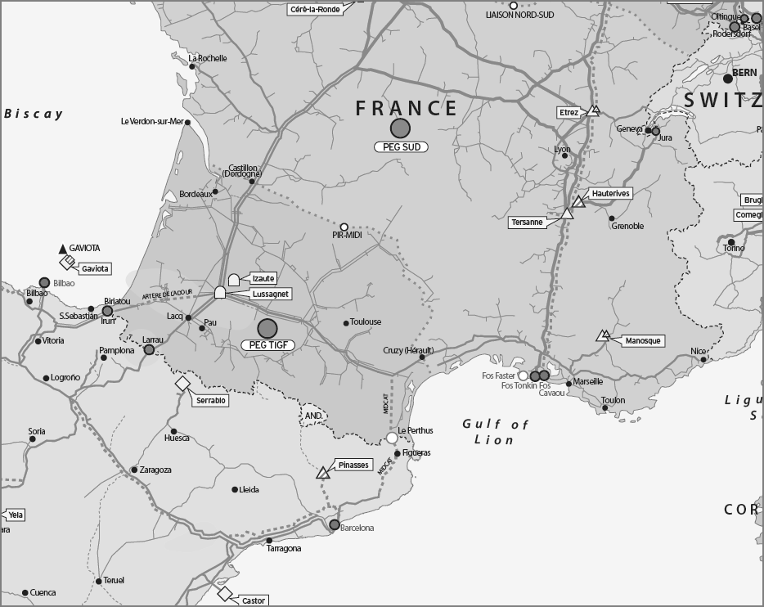
STEP project
1
2
4
3
TSO | Nº | Pipeline / CS | Diameter/ Power | Length | CAPEX (M€)
TIGF | 1 | Barbaira – Border | DN900 - PMS 80bar | 120 km | 290
Enagás | 2 | Figueras – Border | DN900 - PMS 80bar | 28 km | 27
 | 3 | Hostalrich – Figueras | DN900 - PMS 80bar | 79 km | 72
 | 4 | CS Martorell | 36 MW |  | 53
 |  |  |  | Total | 442

Slide 6
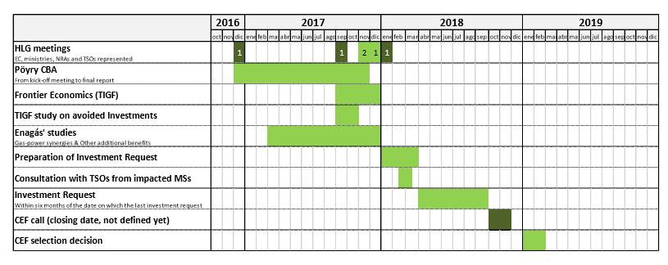
STEP project timeline

Slide 7
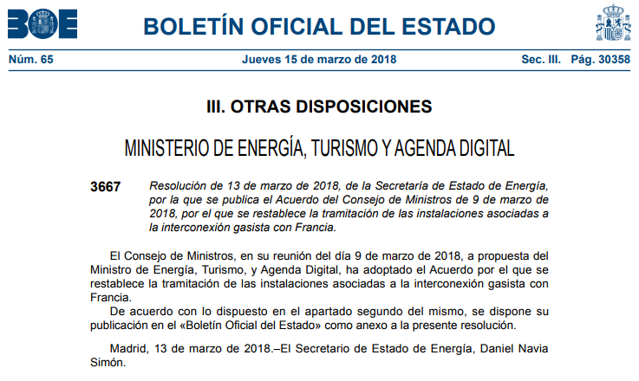
STEP authorisation procedure is restored in Spain

Slide 8
6.1 Follow-up on the OSBB functioning: OS in March 2018

Slide 9
6.1 Follow-up on the OSBB functioning: statistics
VIP PIRINEOS: [07/11/2017 to 08/04/2018]
Days since implementation = 152
 | France to Spain |  | Spain to France
 | (days) | % | (days) | %
OS offered | 57 | 38% | 121 | 80%
not offered : IT issue (Teréga) | 27 | 18% | 27 | 18%
not offered : [Nomination] above trigger value | 68 | 45% | 4 | 3%
not offered : Planned reduction | 0 | 0% | 0 | 0%
for FR > ESP direction : No OS sold
For ESP > FR direction : On day 02/03/2018, all OS sold = 22,5 GWh
    Additional capacity proposed on PRISMA but not subscribed

Slide 10



6.1 Follow-up on the OSBB functioning: OS in March 2018
VIP PIRINEOS: FR - ES
17 GWh/d
Bundled offer – without OS
50 GWh/d
Daily auctions
Unbundled offer – Enagas
1
8th and 9th March: 3 and 12,5 GWh/d booked - Bundled
Allocation of OS capacity: No.
    Additional capacity proposed on PRISMA but not subscribed

Slide 11


6.1 Follow-up on the OSBB functioning: OS in March 2018
VIP PIRINEOS: ES - FR
48 GWh/d
Bundled offer – without OS
50 GWh/d
Daily auctions
Unbundled offer – Enagas
22,5 GWh/d
OS offer
1st, 2nd and 3rd March: 39, 120,5 and 7 GWh/d booked
Allocation of OS: 22,5 GWh/d the 2nd March
1st time

Slide 12
6.1 Follow-up on the OSBB functioning: OS in March 2018
VIP IBERICO. Spain to Portugal
36 GWh/d
Daily auctions
Bundled offer – without OS
Everyday: ≈ 0,04 GWh/d booked.
Allocation of OS capacity: No.

Slide 13
7 AOB

Slide 14



7. Technical Capacity Calculation at VIPs
In response to the NRAs request about capacity calculation topic, latest steps are the following :
During March/April, contacts and a technical meeting between REN and Enagas has taken place to discuss technical capacity topics at the VIP Ibérico:
Main aspects to further develop according to NC-CAM (on-going):
  Review of technical capacity agreement for more than one year (at least for the upcoming 5 gas years).
  Dynamic Capacity Calculation Approach according to Art. 6.1.a.4 on ST basis depending on boundary conditions such as local demand, temperatures, nominations…
On going. Under conversations between both TSOs on the Dynamic Capacity Calculation approach at VIP Pirineos.

Slide 15
Thank you for your attention!

