Slide 1
50th IG meeting
17th June 2019

Slide 2
2.1. Follow-up of infrastructures developments (PCIs, TYNDP, GRIP…)

Slide 3
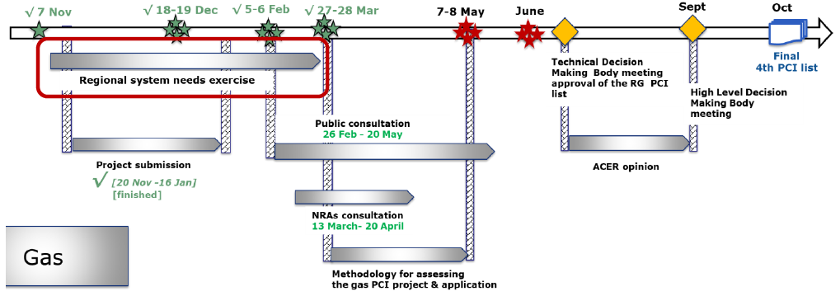
2.1 PCI selection process
Next Regional Group meeting scheduled on 27th and 28th June:
  PCI assessment methodology
  Discussion and validation of the methdology
  Application to each candidate project and the ranking of candidate projects

Slide 4
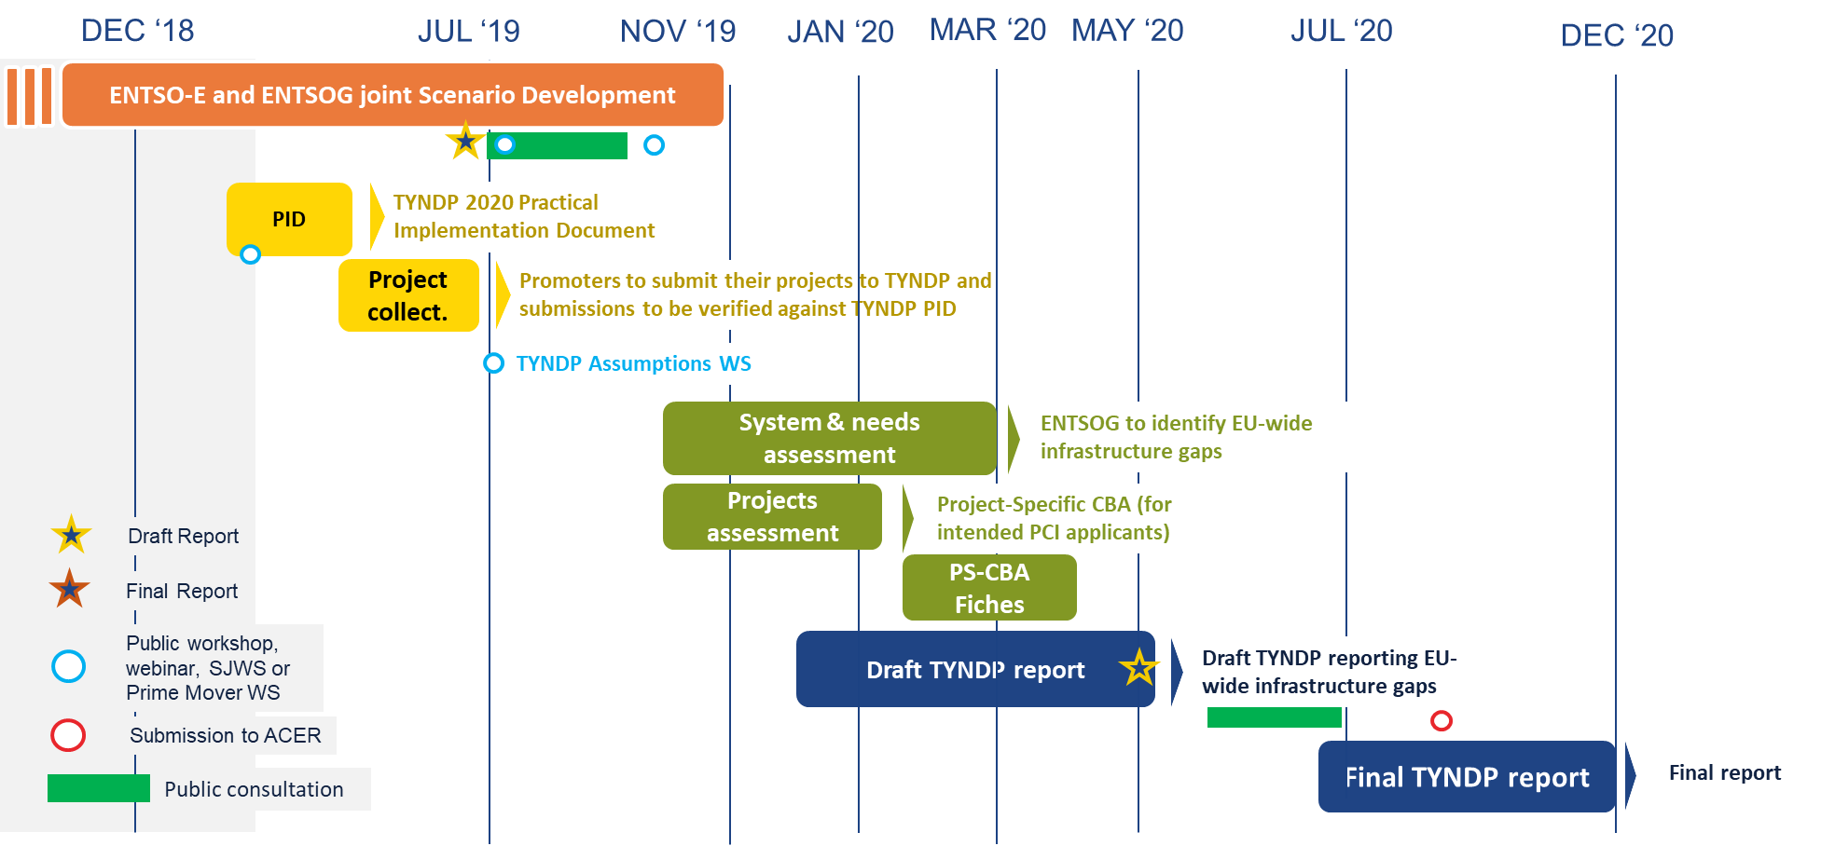
2.1 TYNDP 2020

Slide 5
2.1 GRIP 2019

Slide 6
2.2. VIP Ibérico: update on capacity offered in yearly auctions for the period 2019-2024

Slide 7
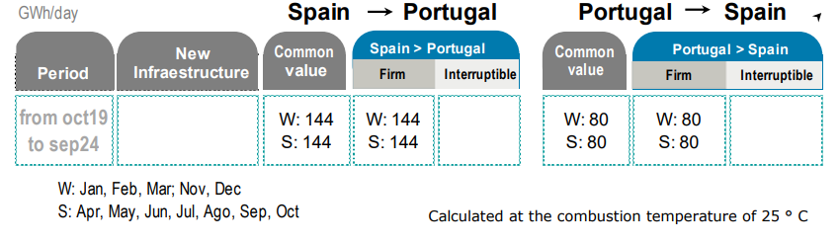



2.2. VIP Ibérico: calculation of capacity to be offered in PRISMA for the next 5 gas years
In response to the Iberian NRAs request, REN and Enagas have been working on the technical analysis of the capacity to be offered for the next 5 gas year at VIP IBERICO. This analysis was sent to Iberian NRAs at the end of March.
Both Enagás and REN commit to maintain the current technical firm capacity of 144/80 GWh/d in the VIP IBERICO for the next 5 years.
Capacity update was published at the websites before the first Monday of June according to CAM-NC.
https://www.enagas.es/enagas/en/Gestion_Tecnica_Sistema/Capacidades_e_infraestructuras_del_Sistema/Capacidad_Tecnica_interconexiones
https://www.ign.ren.pt/web/guest/gestao-tecnica.

Slide 8
VIP IBERICO: Capacity to be offered
Yearly auction
 | Technical capacity at Yearly auction 2nd July 2018 [GWh/d 0ºC] | Technical capacity at Yearly auction 1st July 2019 [GWh/d 0ºC]
Gas Year 2018 (Oct 2018-Sept 2019) | 80,21 | -
Gas Year 2019 (Oct 2019-Sept 2020) | 80,21 | 80,21
Gas Year 2020 (Oct 2020-Sept 2021) | 80,21 | 80,21
Gas Year 2021 (Oct 2021-Sept 2022) | 80,21 | 80,21
Gas Year 2022 (Oct 2022-Sept 2023) | 80,21 | 80,21
Gas Year 2023 (Oct 2023-Sept 2024) | - | 80,21
 | Technical capacity at Yearly auction 2nd July 2018 [GWh/d 0ºC] | Technical capacity at Yearly auction 1st July 2019 [GWh/d 0ºC]
Gas Year 2018 (Oct 2018-Sept 2019) | 144,37 | -
Gas Year 2019 (Oct 2019-Sept 2020) | 134,35 | 144,37
Gas Year 2020 (Oct 2020-Sept 2021) | 134,35 | 144,37
Gas Year 2021 (Oct 2021-Sept 2022) | 134,35 | 144,37
Gas Year 2022 (Oct 2022-Sept 2023) | 134,35 | 144,37
Gas Year 2023 (Oct 2023-Sept 2024) | - | 144,37

Slide 9
3. Market integration

Slide 10
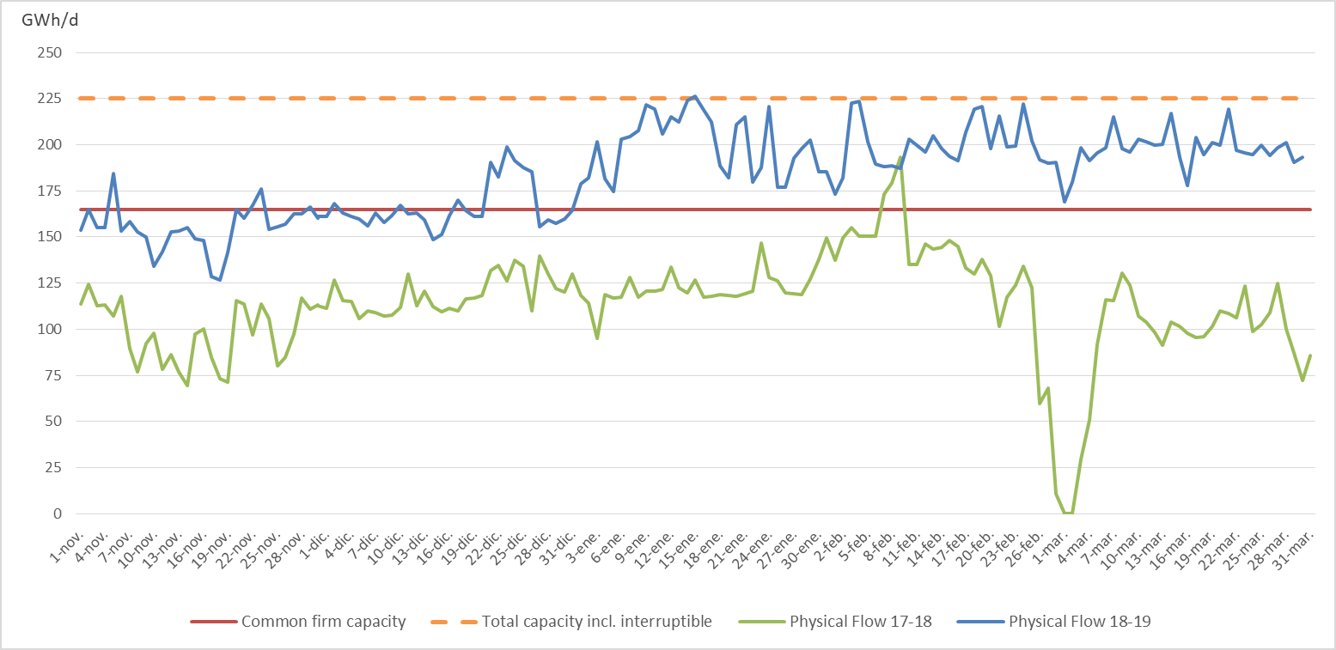
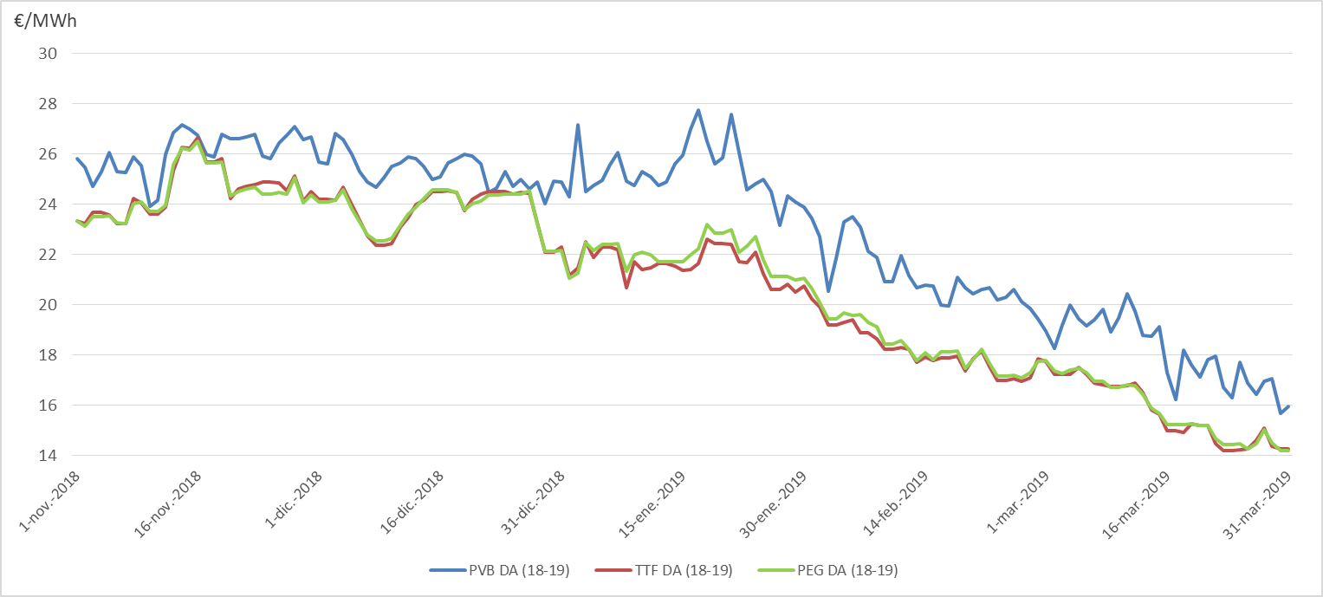
3.2 Follow-up gas prices: VIP Pirineos

Slide 11
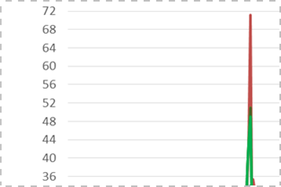
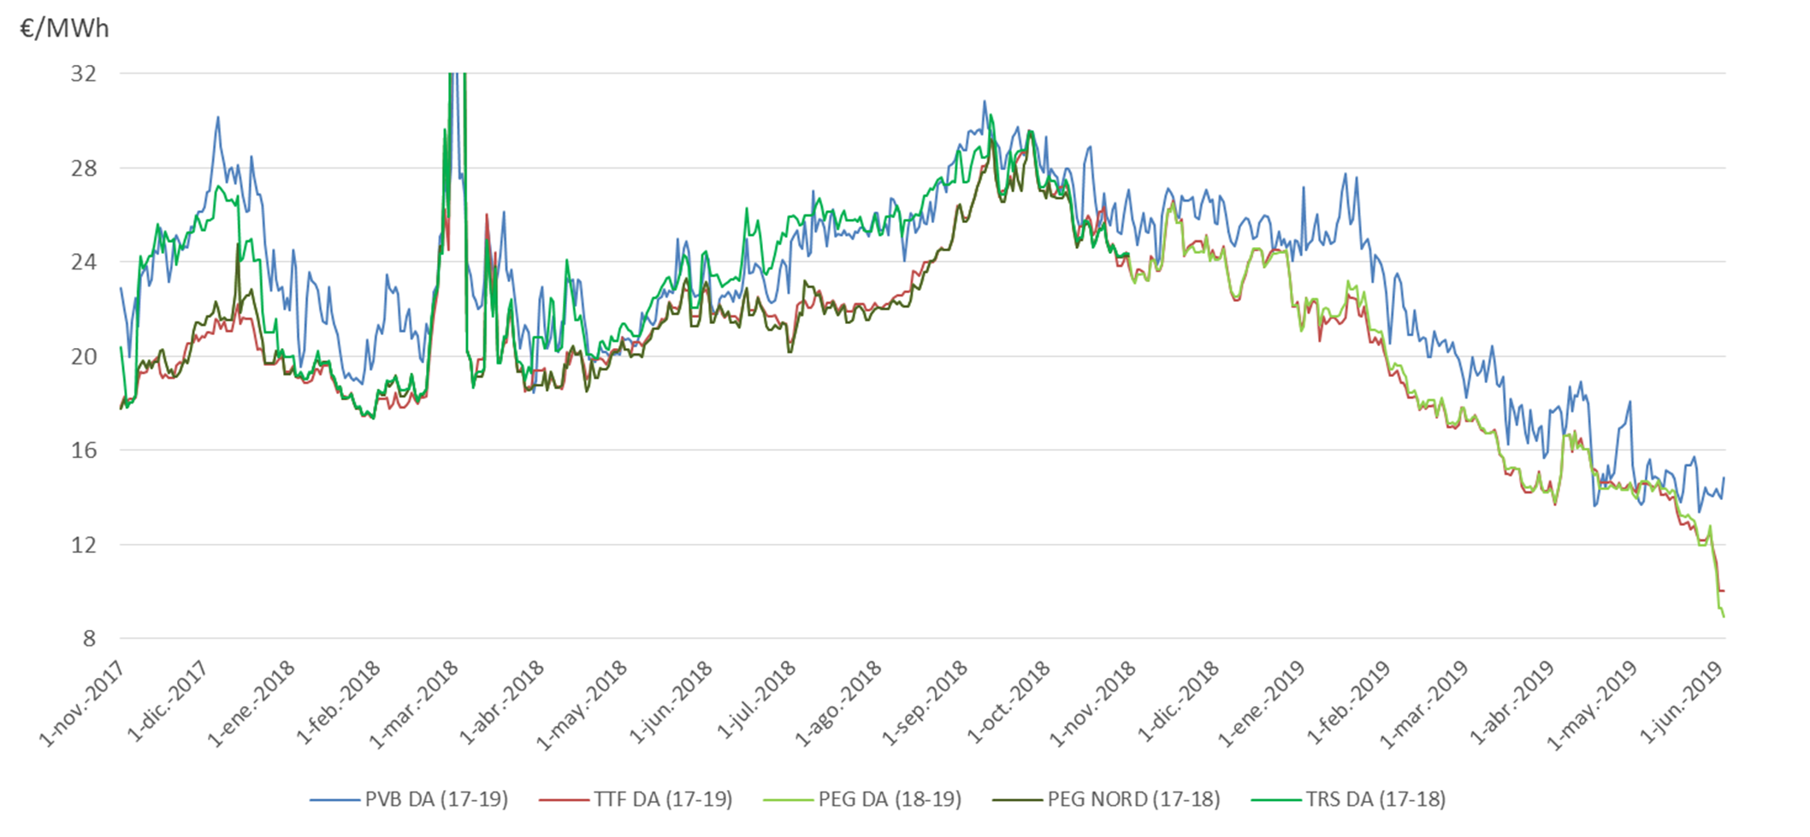
3.2 Follow-up gas prices: VIP Pirineos

Slide 12
4. WP Third target. Contribution of gases to decarbonisation

Slide 13





4.1. Follow-up - Projects
  Power to Green Hydrogen Mallorca
  RenovaGas
  SUN2HY (Sun to Hydrogen)
  Energy solutions
  Demonstrative facility in Zaragoza for standardised quality and flow rate measurements for hydrogen
  FenHYx
  Standardised quality measurements for European biomethane (RICE)
  Innovation in renewable gases
  Jupiter 1000
  Energy efficiency R&D
  New solutions for biomethane and future projects such as Power to Gas

Slide 14



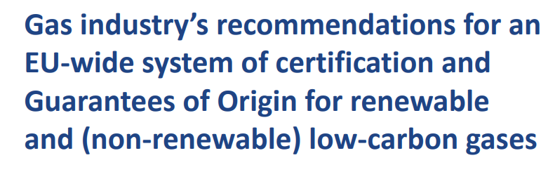







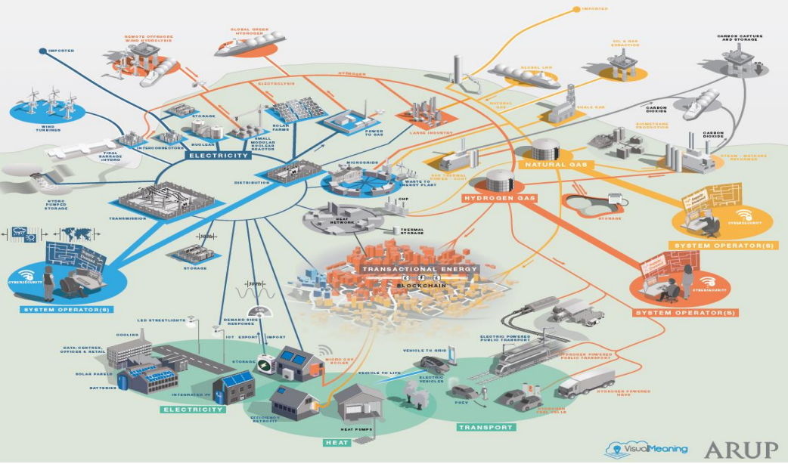











4.1. Follow-up – Gas organisation initiatives

Slide 15
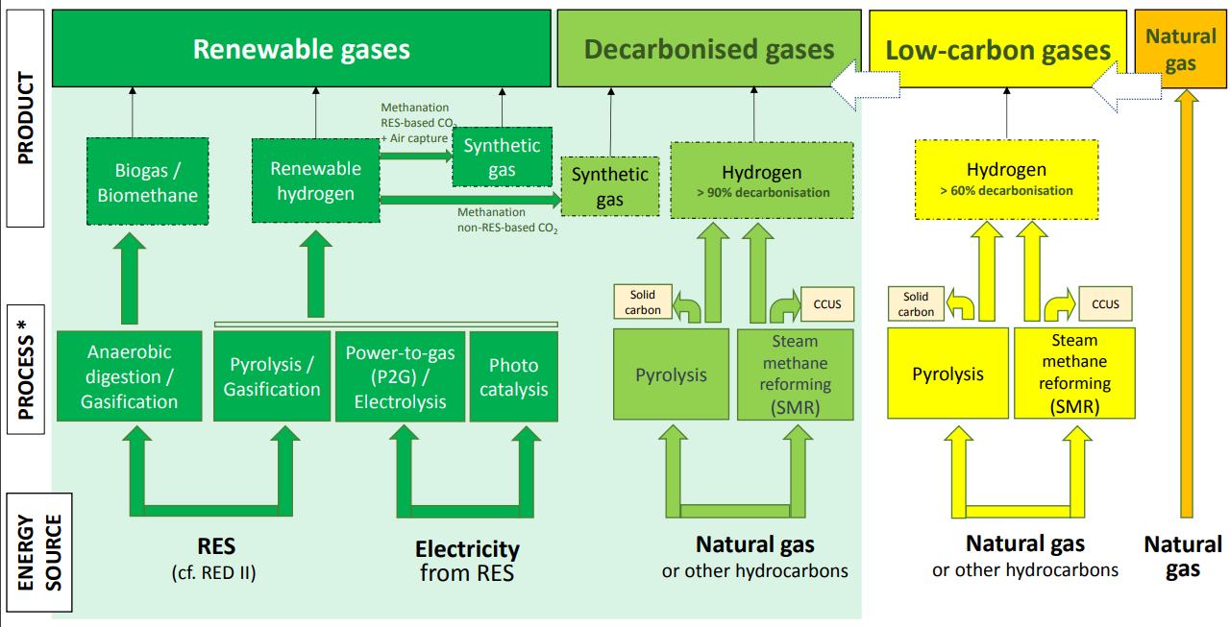
4.1. Follow-up – Gas organisation initiatives
Align gas terminology

Slide 16
Thank you for your attention!

